Slide 1
Income Classification Using Apache Spark and Machine Learning
Mona Kashani

Slide 2
1.
Introduction

Slide 3
Many of us had aspirations of becoming doctors or pilots when we were young. We ultimately opted against pursuing these lucrative but arduous careers after taking into account their challenges. The areas of medicine, engineering, law, and financial management are all satisfying careers.
However, years of training and expertise are necessary to earn such a substantial income. Therefore, it is a wise idea to be aware of the greater salaries according to the information we had. and this is the reason I've decided on this subject. The goal of this project is to recognize and identify people who make more than $50,000 annually.

Slide 4
2.
Exploring the Dataset

Slide 5
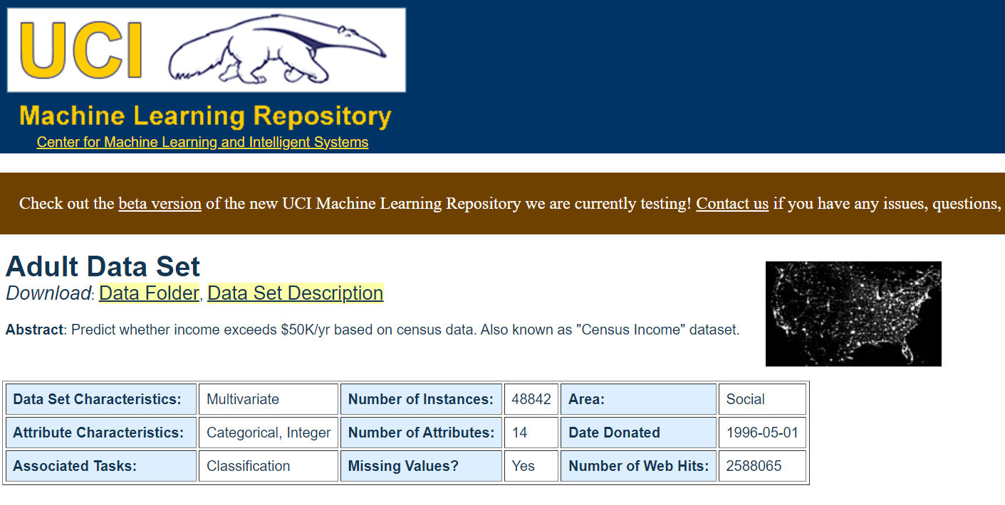
Dataset
The dataset that is used in this project is downloaded from the UCI Machine Learning Repository. The dataset contains 48,842 instances in total with 14 attributes. It was originally gathered in 1994. This project aims to predict whether a person will make more than 50,000$ a year or not. This is done using Apache Spark and Machine Learning algorithms.

Slide 6
Dataset Description
Column Name | Data Type | Description
income | nominal | Whether a person’s income over a year is over 50K or not
age | numeric | Age of the person
workclass | nominal | Class of the work, for instance; private, self-employed, etc.
fnlwgt | numeric | Final weight
education | nominal | Education level of the person
education-num | numeric | Education level of the person
marital-status | nominal | self-explanatory
occupation | nominal | Category of the person’s job

Slide 7
Dataset Description
Column Name | Data Type | Description
relationship | nominal | Kind of the relationship the person has
race | nominal | self-explanatory
sex | nominal | self-explanatory
capital-gain | numeric | Amount of capital gained by the person over a year
capital-loss | numeric | Amount of capital lost by the person over a year
hours-per-week | numeric | How many hours the person does work in a week
native-country | string | self-explanatory

Slide 8
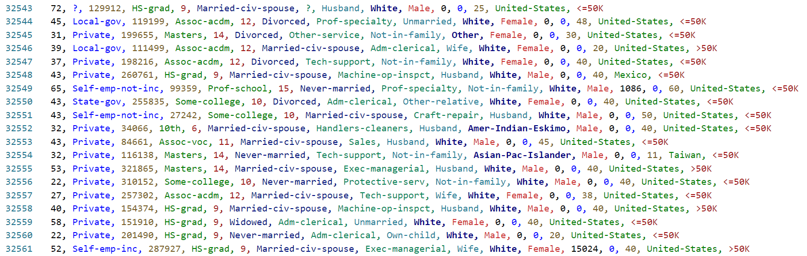
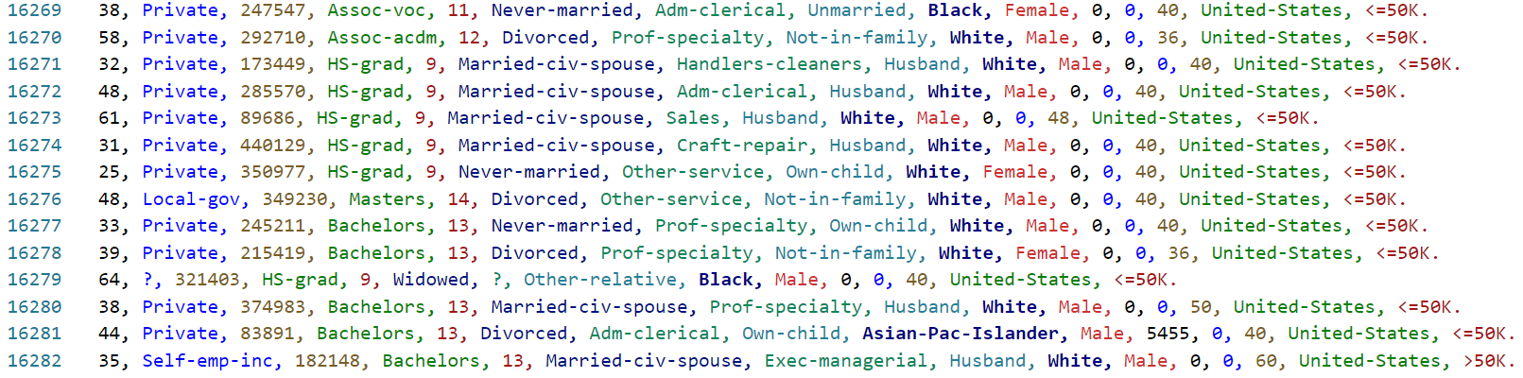
Dataset Description
adult.data file
(Training Data)
adult.test file
(Testing Data)

Slide 9
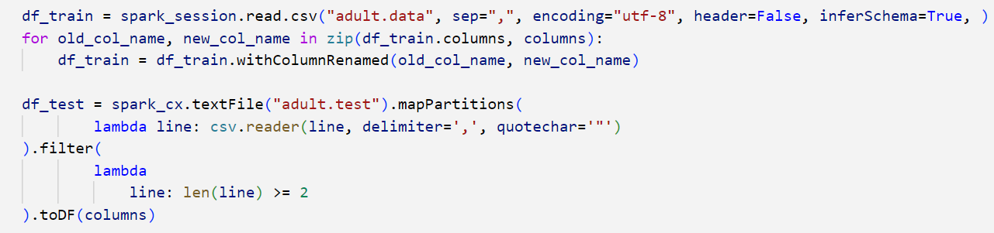
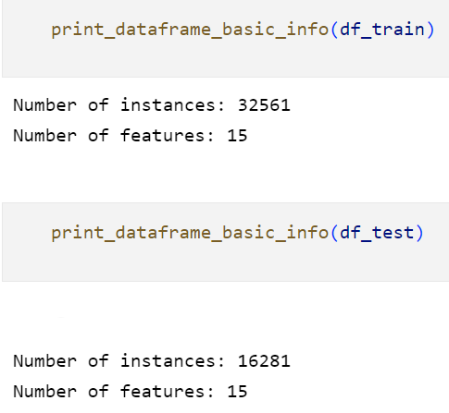
Create the data frames

Slide 10
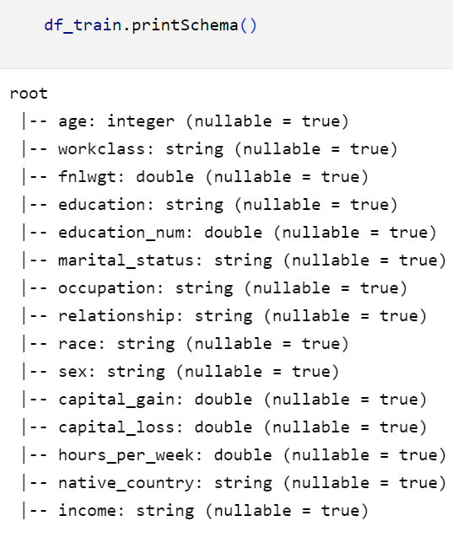
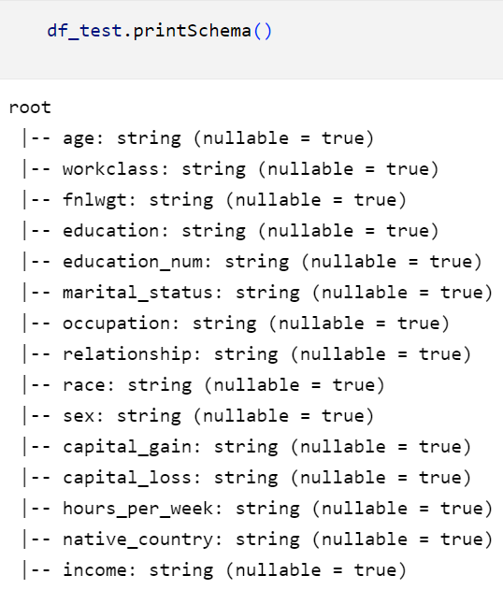
Dataframe Schema

Slide 11
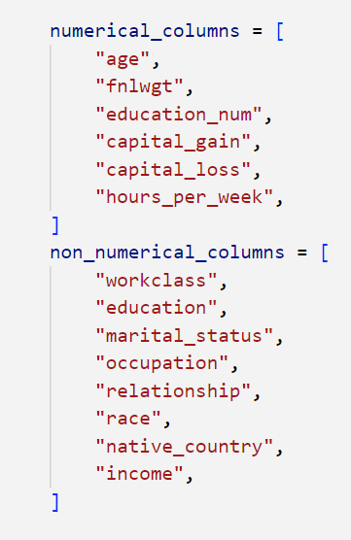
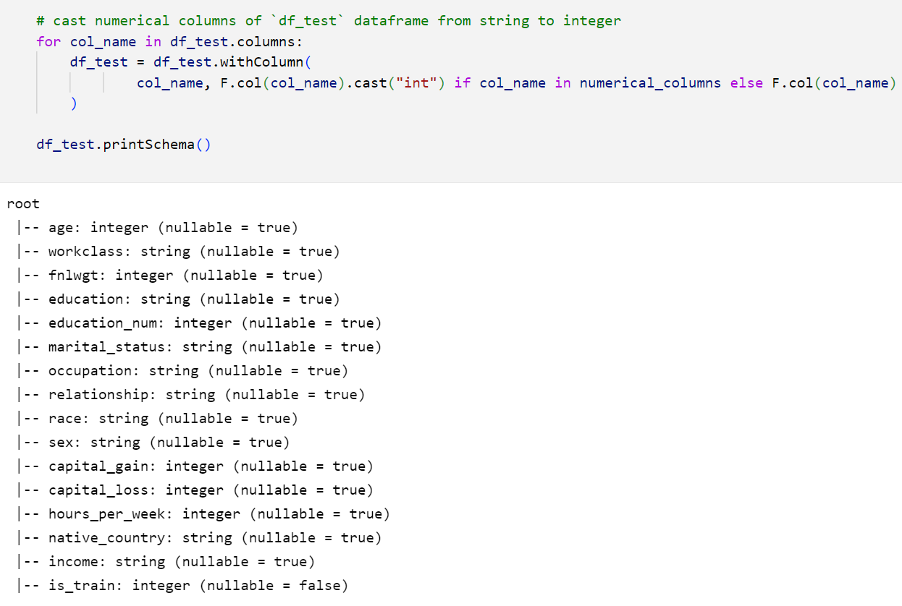
Fix test dataframe schema

Slide 12
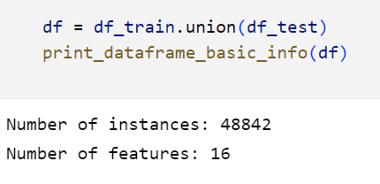
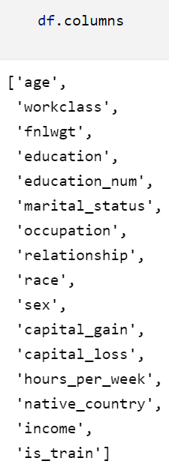
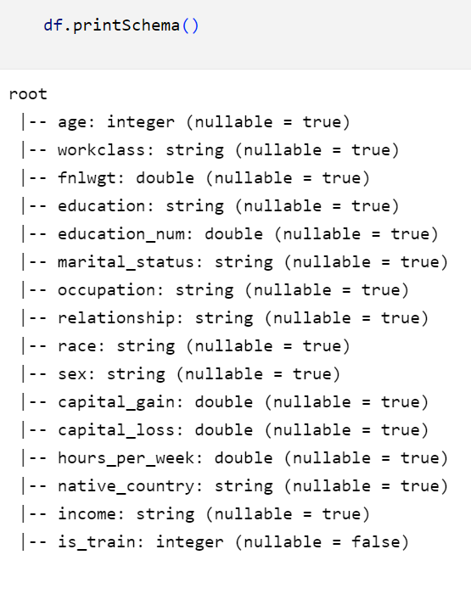
Merge train and test data frames

Slide 13
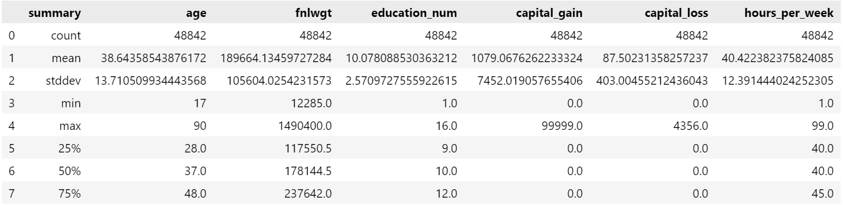
Numerical Columns Summary

Slide 14
3.
Data Cleaning

Slide 15
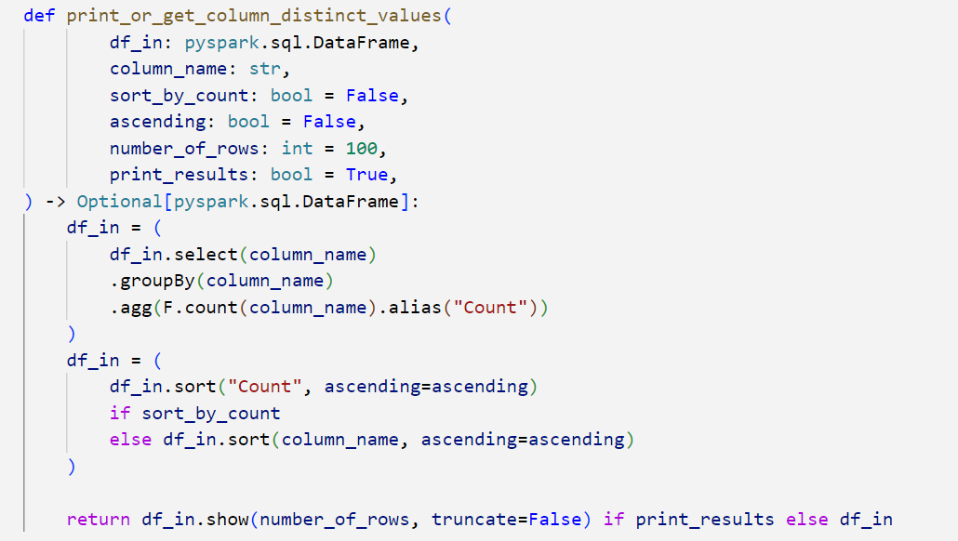
Get column distinct values

Slide 16
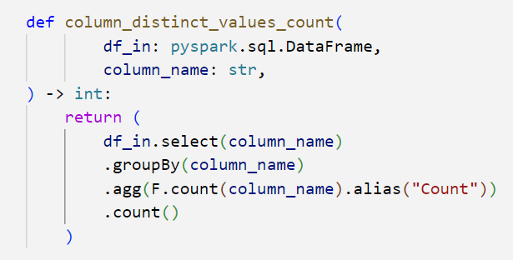
Get column distinct values

Slide 17
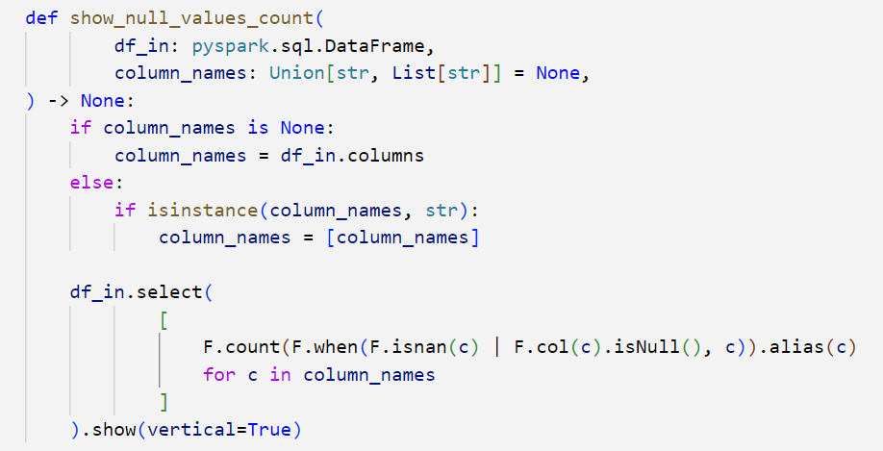
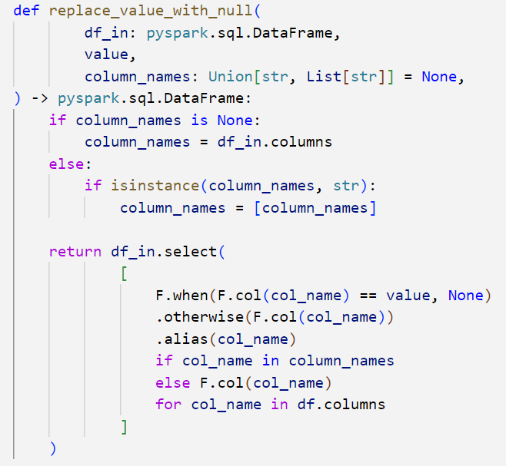
Handling data frame null values

Slide 18
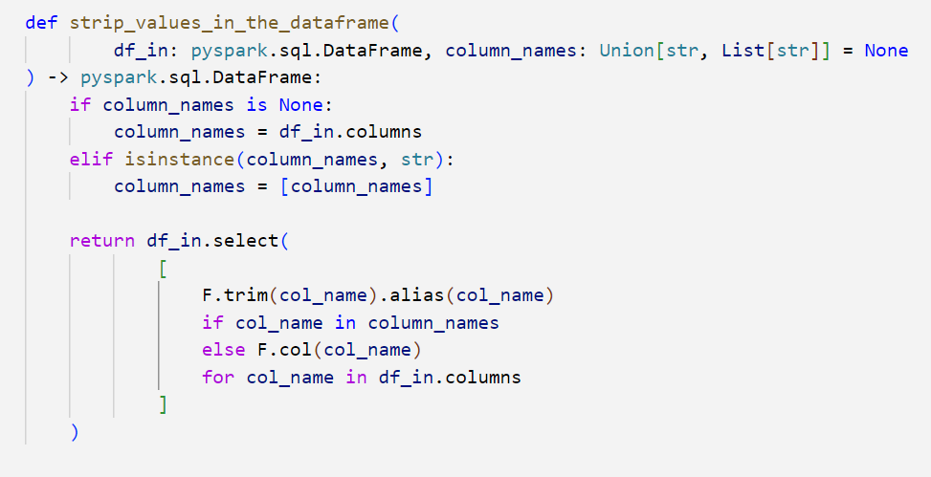
Strip values of categorical columns

Slide 19
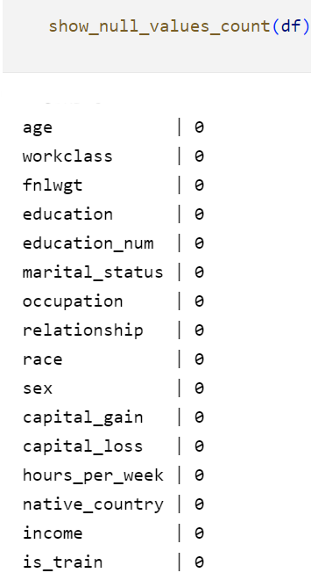
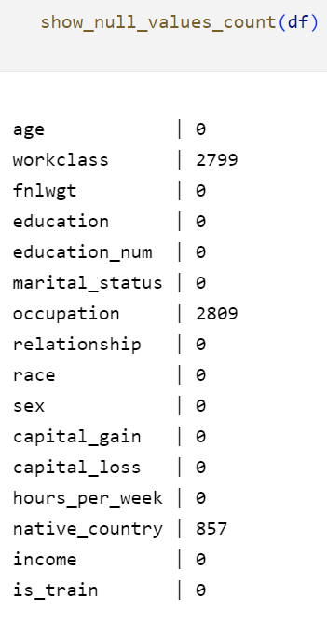
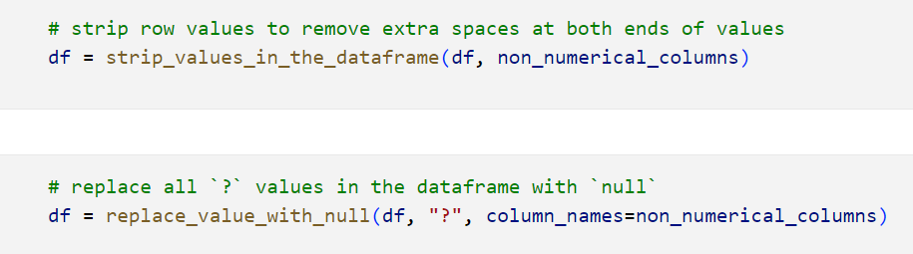
Show dataframe null values

Slide 20
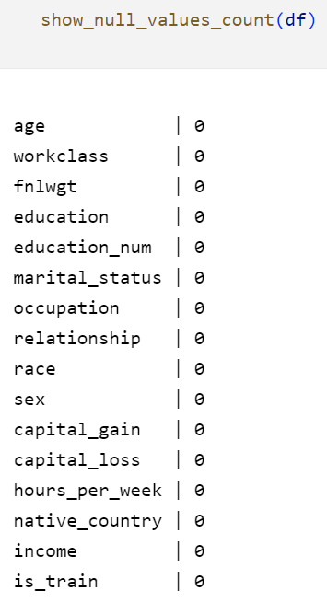
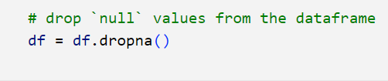
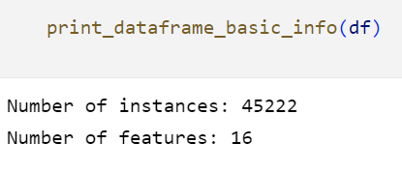
Drop dataframe null values

Slide 21
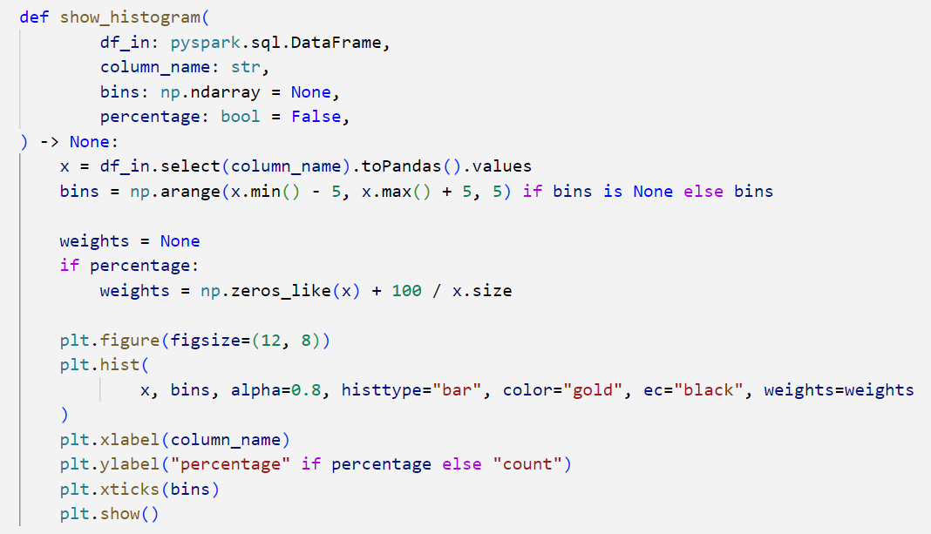
Histogram function

Slide 22
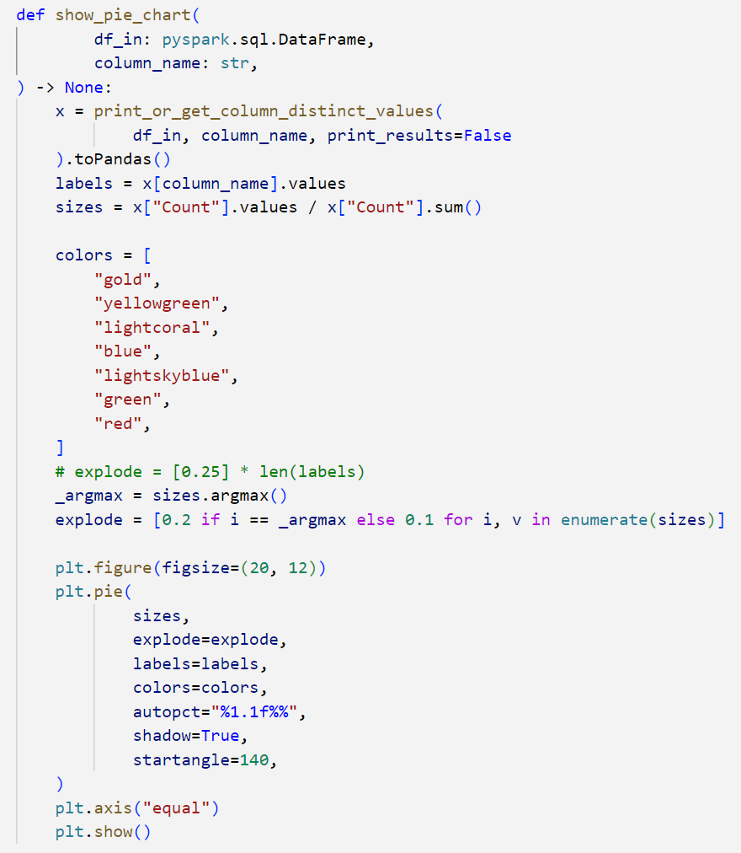
Pie Chart function

Slide 23
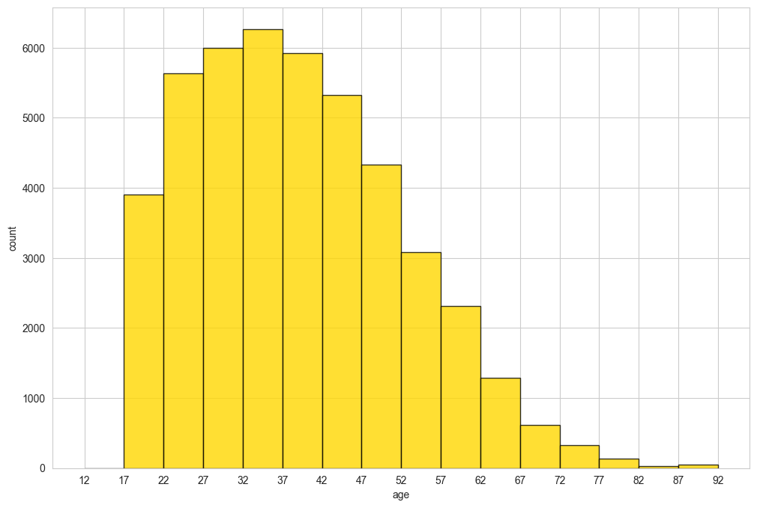
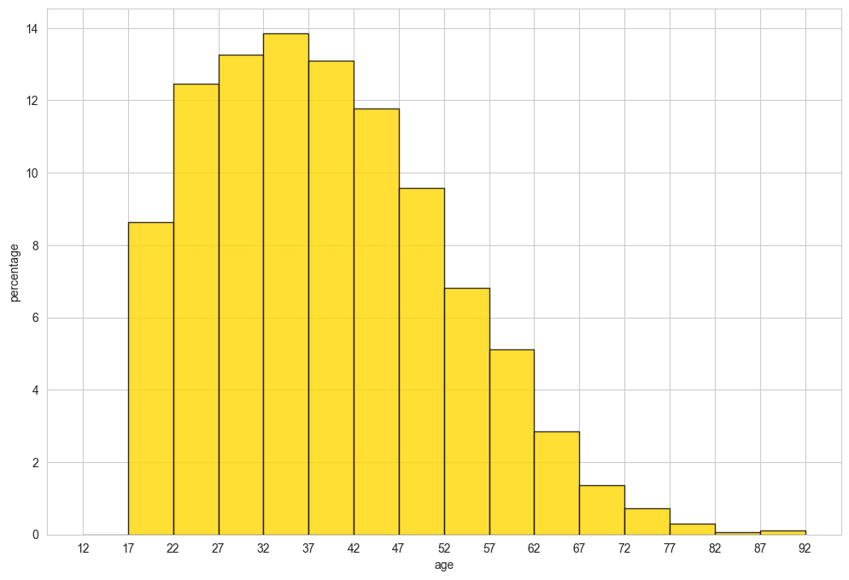
Age attribute

Slide 24
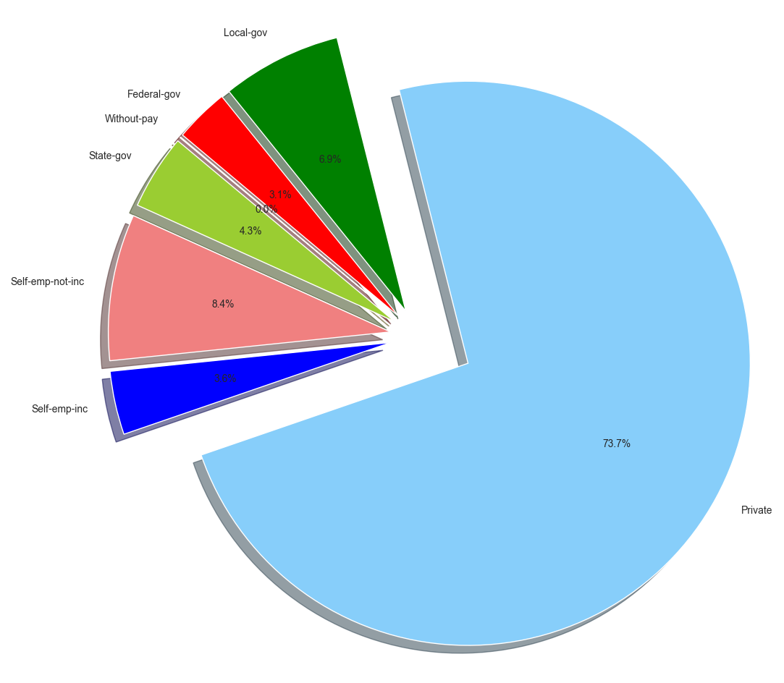
Work class attribute

Slide 25
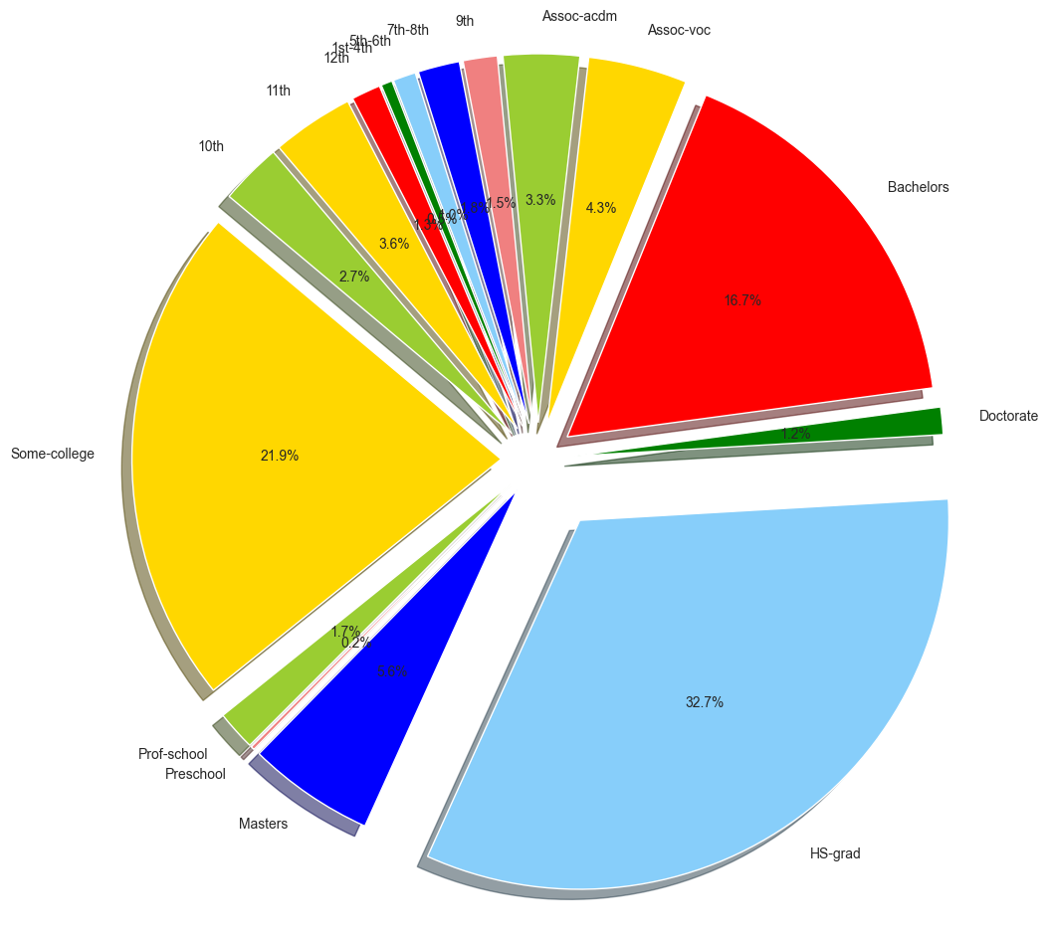
Education attribute

Slide 26
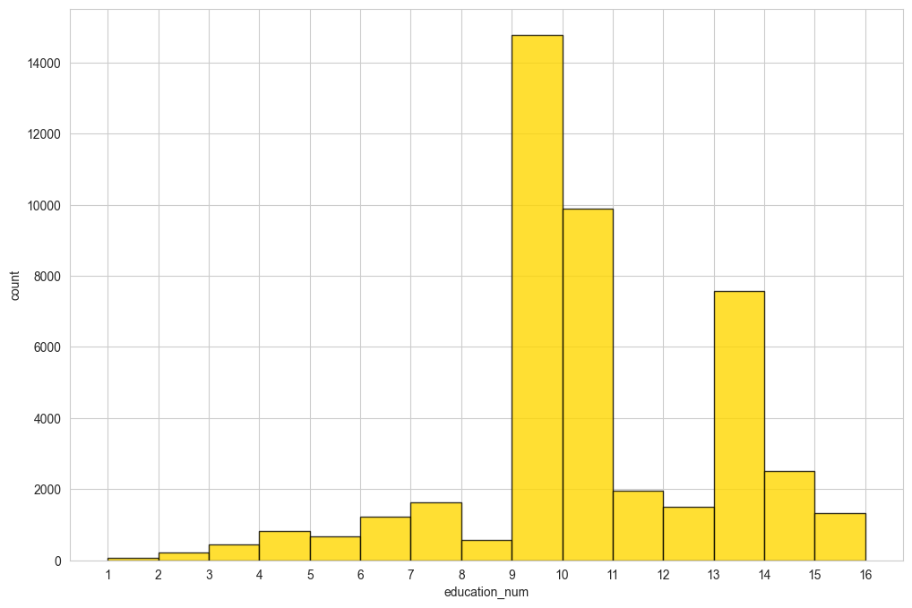
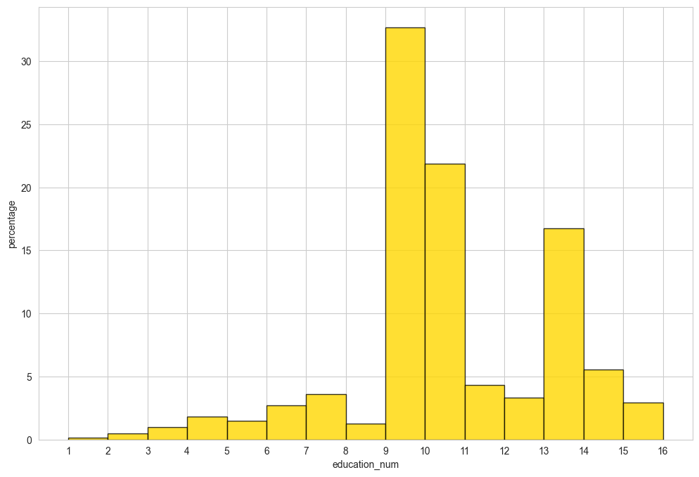
Education num attribute

Slide 27
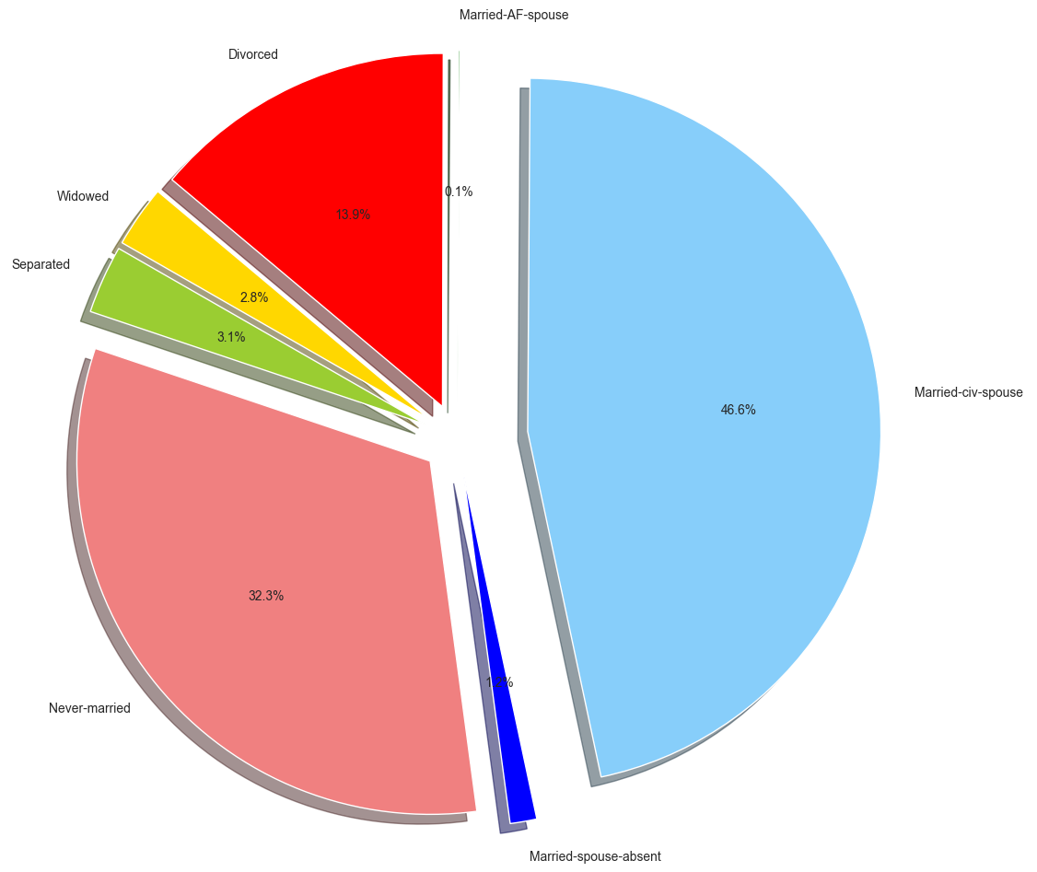
Marital status attribute

Slide 28
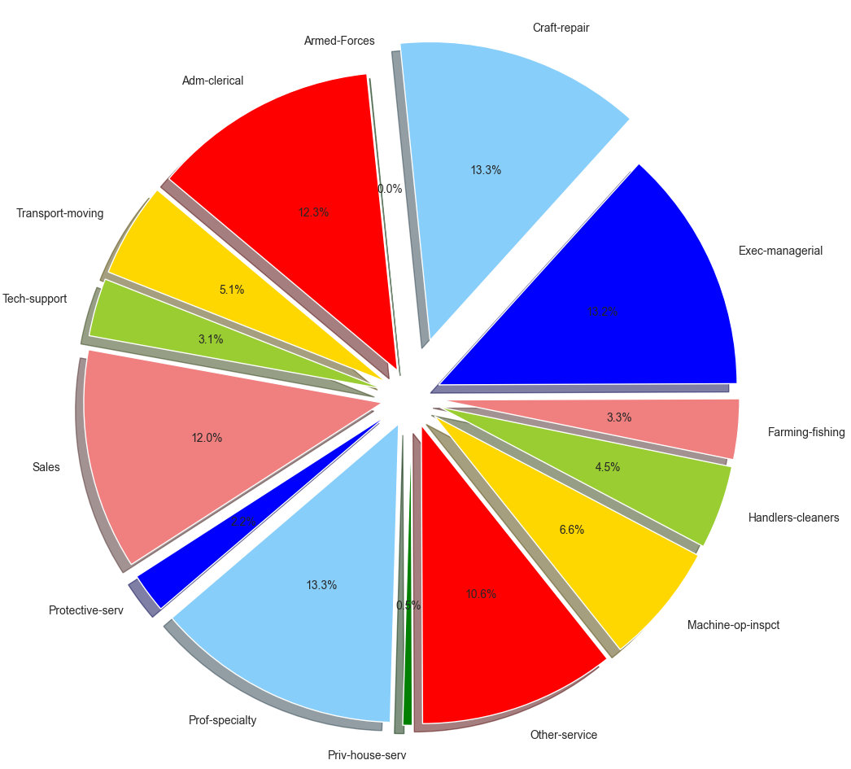
Occupation attribute

Slide 29
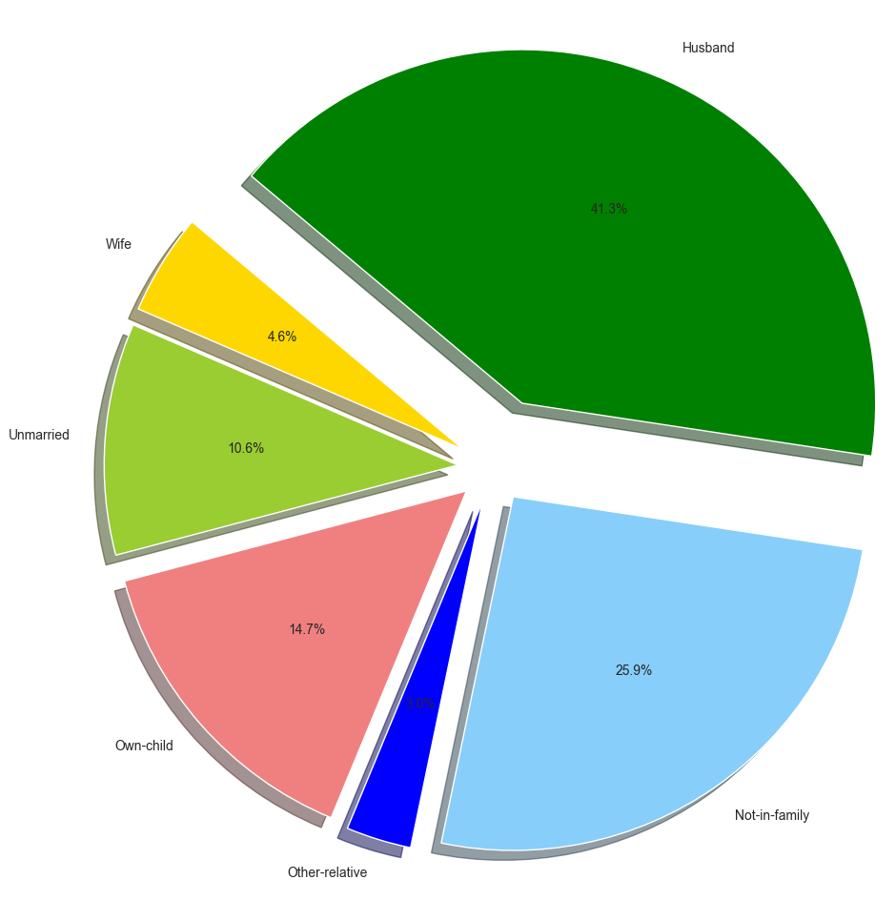
Relationship attribute

Slide 30
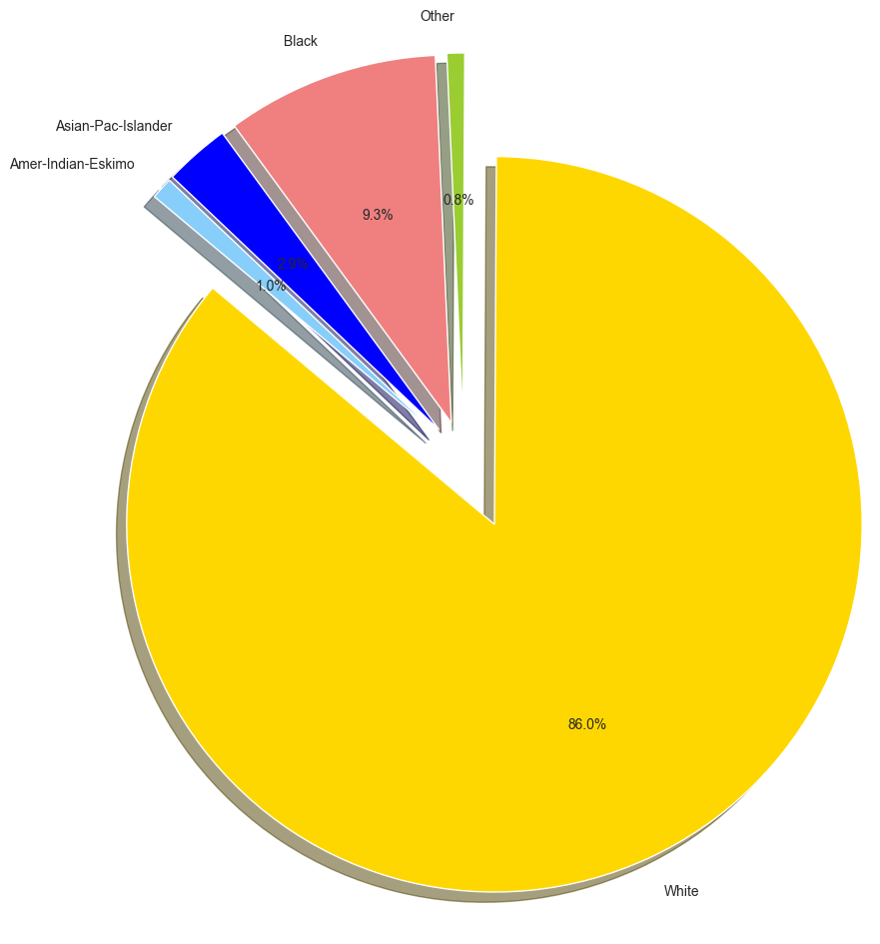
Race attribute

Slide 31
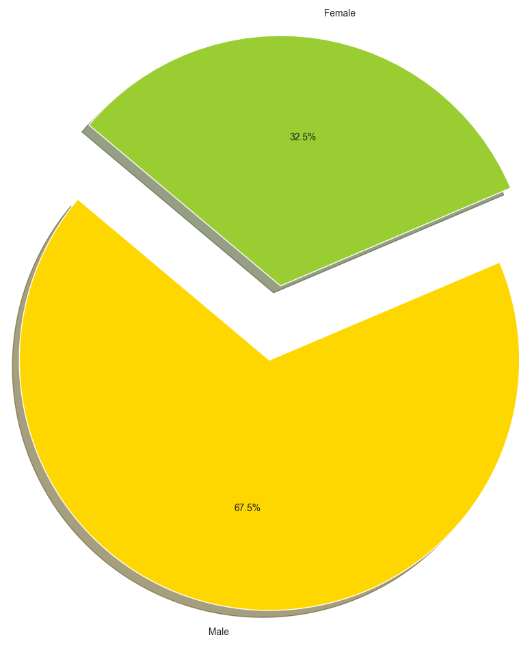
Sex attribute

Slide 32
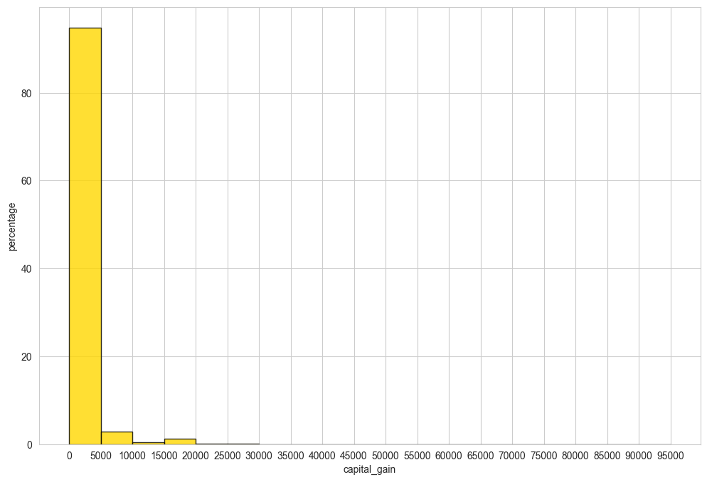
Capital gain attribute

Slide 33
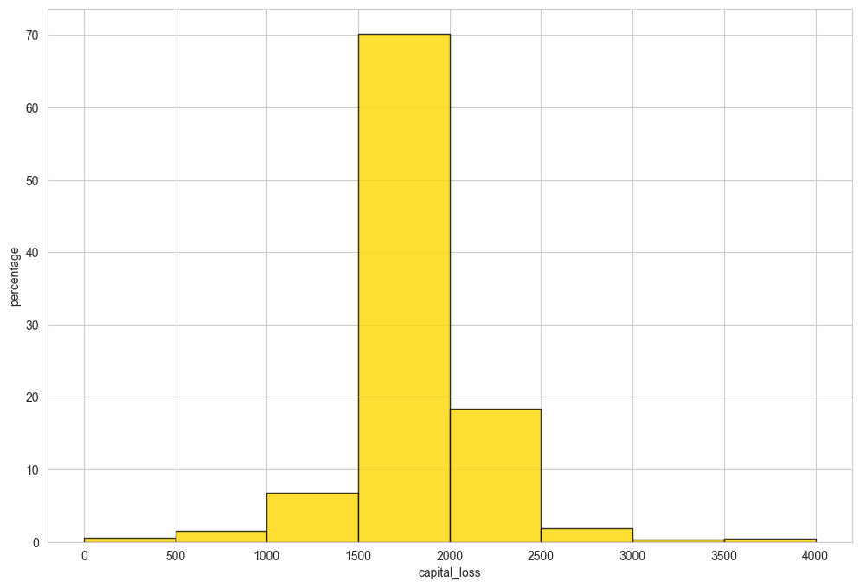
Capital loss attribute

Slide 34
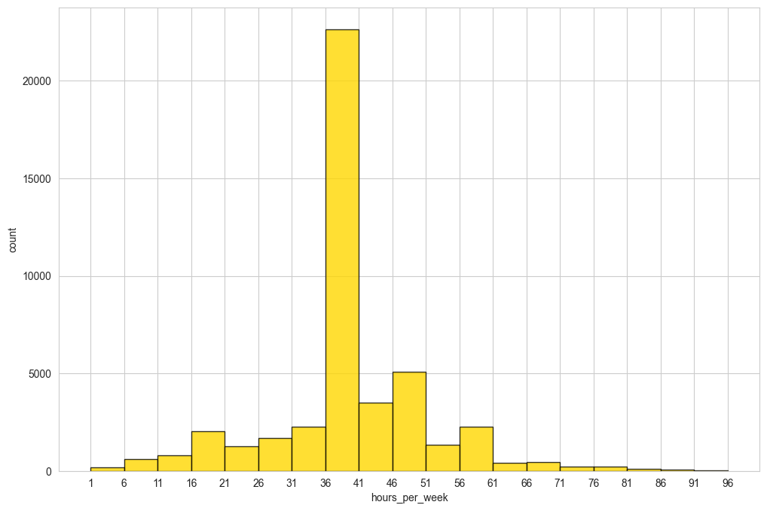
Hours per week attribute

Slide 35
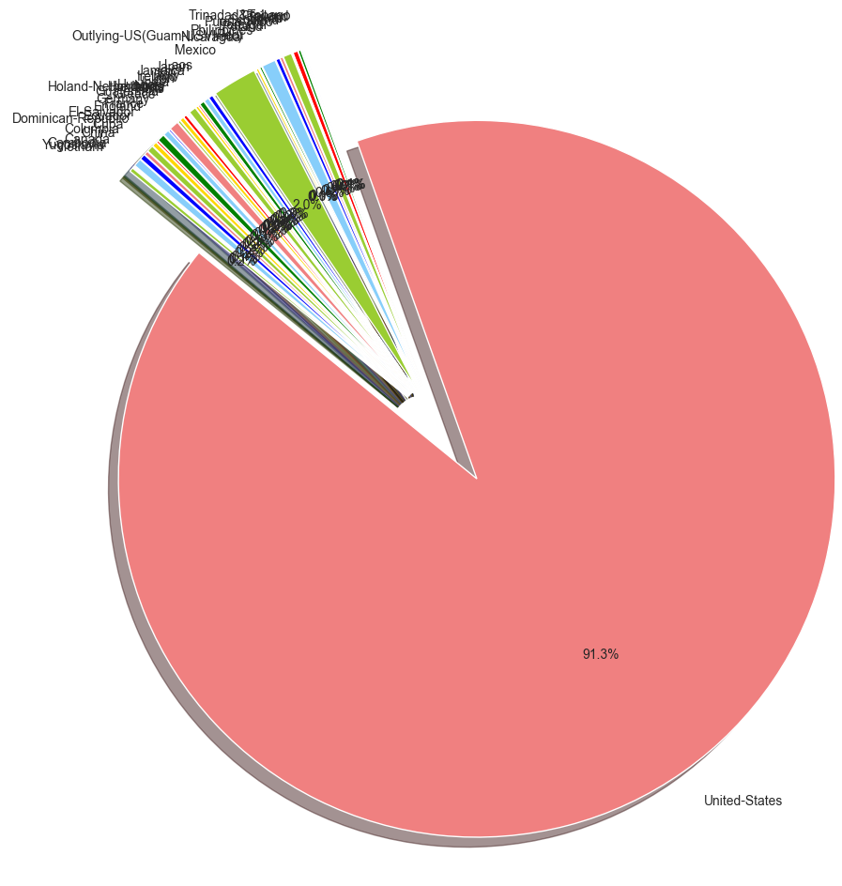
Native country attribute

Slide 36
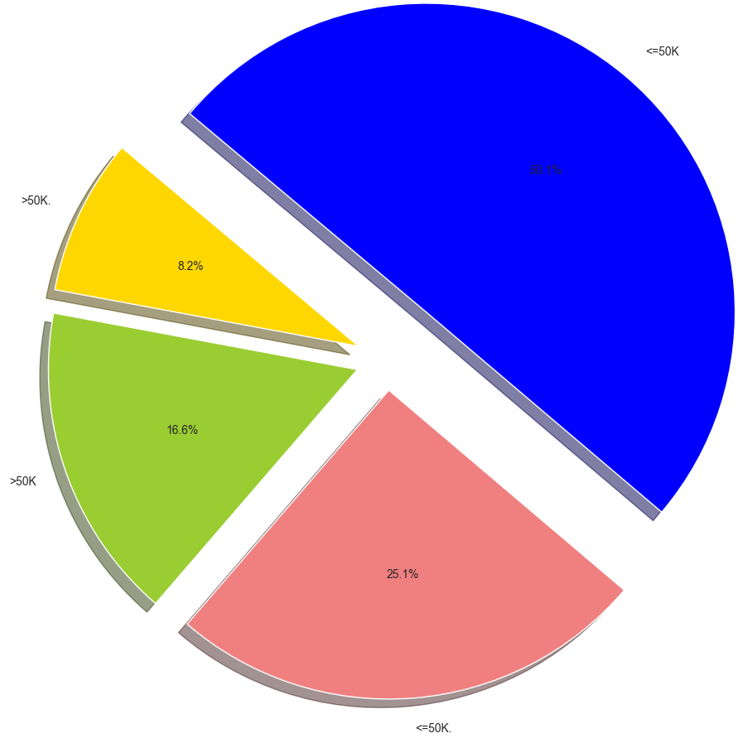
Income attribute

Slide 37
4.
Feature Engineering

Slide 38
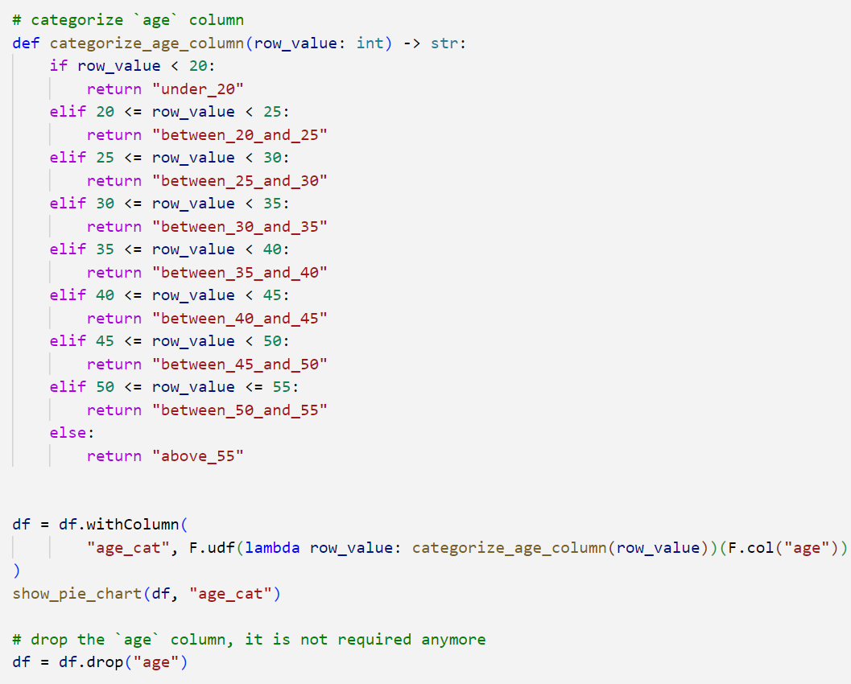
Categorize age attribute

Slide 39
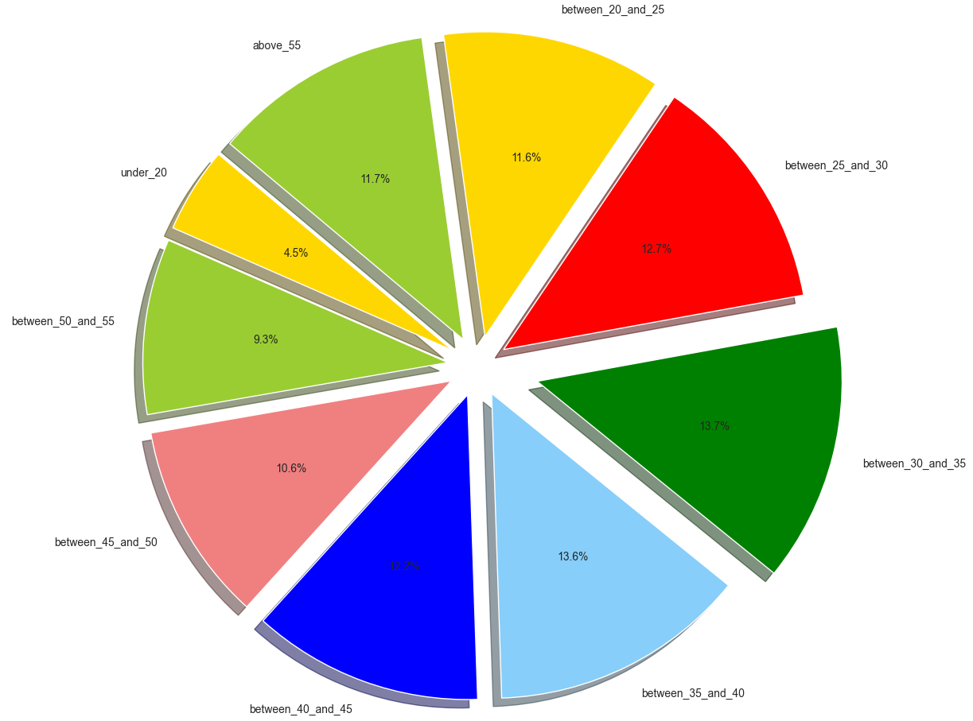
Categorize age attribute

Slide 40
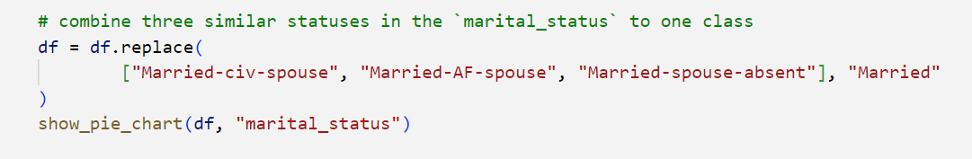
Combine similar values in marital status attribute

Slide 41
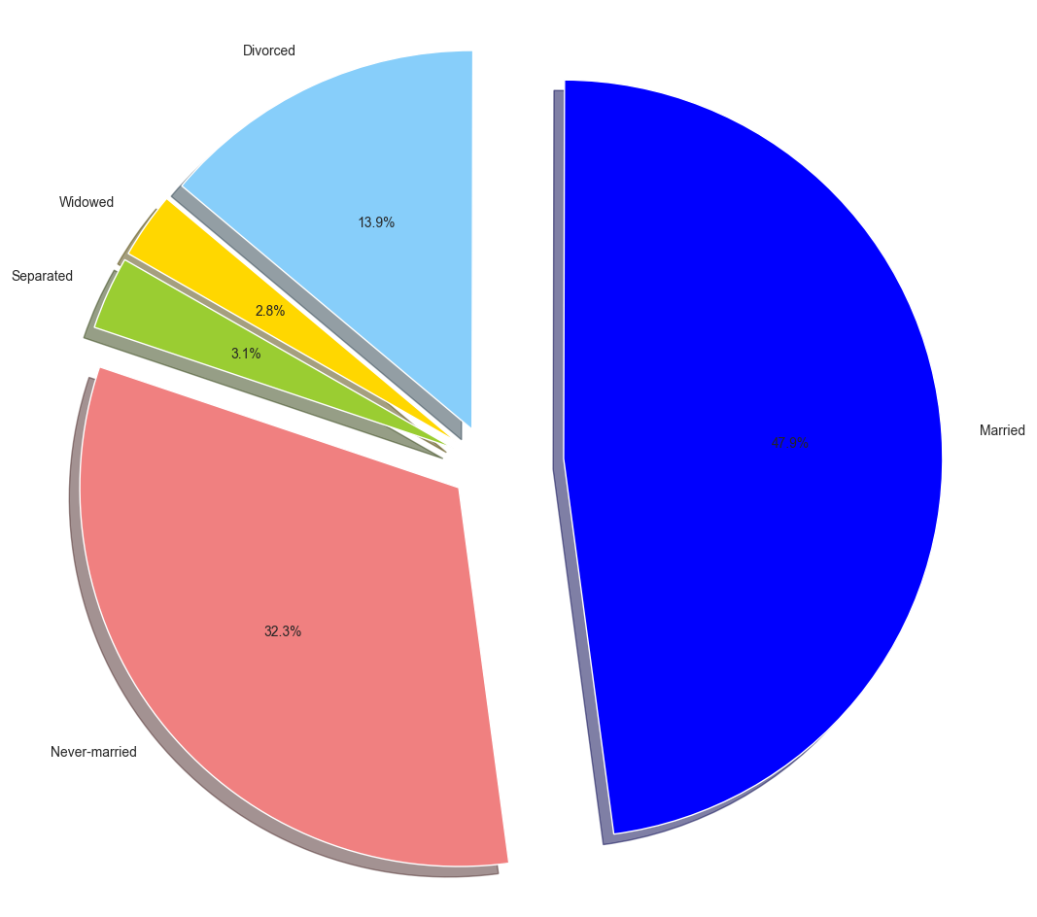
Combine similar values in marital status attribute

Slide 42
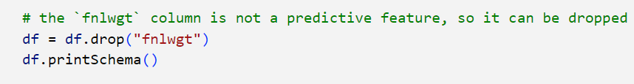
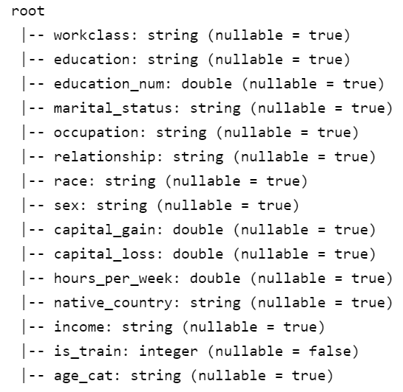
fnlwgt attribute

Slide 43
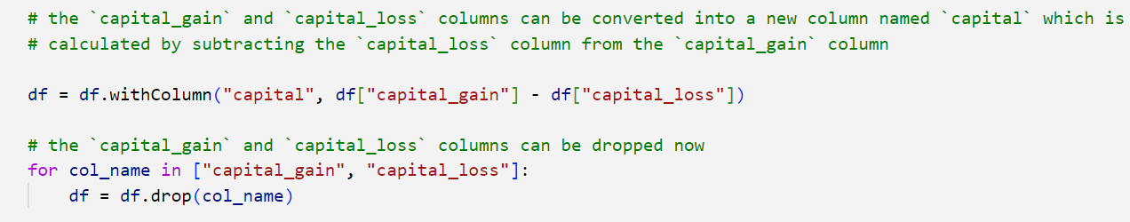

Combine capital gain and capital loss to create a new attribute

Slide 44
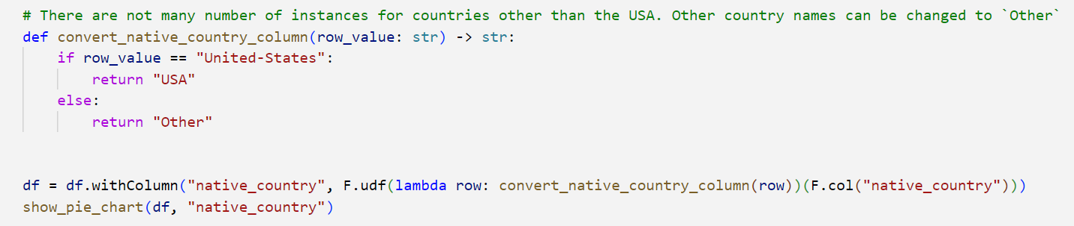
Combine similar values in native country attribute

Slide 45

Combine similar values in native country attribute

Slide 46
Drop the education num attribute

Slide 47

Combine similar values in relationship attribute

Slide 48

Combine similar values in relationship attribute

Slide 49

Categorize hours per week attribute

Slide 50

Categorize hours per week attribute

Slide 51

Convert income attribute to numerical

Slide 52

Convert income attribute to numerical

Slide 53


Final dataframe schema

Slide 54
5.
Model Training

Slide 55

Create a pipeline

Slide 56

Split the dataframe to train and test sets

Slide 57

Decision Tree Classifier

Slide 58


Decision Tree Classifier
Training results
Test results

Slide 59

Random Forest Classifier

Slide 60


Random Forest Classifier
Training results
Test results

Slide 61

Linear SVC

Slide 62


Linear SVC
Training results
Test results

Slide 63

Linear Regression

Slide 64


Linear Regression
Training results
Test results

Slide 65

GBT Classifier

Slide 66


GBT Classifier
Training results
Test results

Slide 67
Comparing models
 | Accuracy | Precision | Recall | F1 score | AUC | AUC-PR
Decision Tree | 0.779 | 0.754 | 0.169 | 0.276 | 0.738 | 0.412
Random Forest | 0.856 | 0.818 | 0.542 | 0.652 | 0.911 | 0.801
Linear SVC | 0.847 | 0.740 | 0.594 | 0.659 | 0.898 | 0.760
Linear Regression | 0.842 | 0.677 | 0.700 | 0.688 | 0.902 | 0.765
GBT | 0.876 | 0.818 | 0.647 | 0.723 | 0.934 | 0.848
Training
 | Accuracy | Precision | Recall | F1 score | AUC | AUC-PR
Decision Tree | 0.783 | 0.765 | 0.166 | 0.273 | 0.740 | 0.410
Random Forest | 0.852 | 0.797 | 0.531 | 0.637 | 0.901 | 0.779
Linear SVC | 0.846 | 0.730 | 0.592 | 0.653 | 0.897 | 0.754
Linear Regression | 0.839 | 0.665 | 0.695 | 0.680 | 0.900 | 0.757
GBT | 0.860 | 0.771 | 0.613 | 0.683 | 0.911 | 0.800
Test

Slide 68
Thanks!
Any questions?

